Slide 1
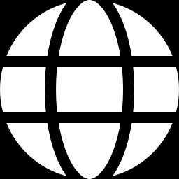
Cross-Linguistic Inequalities in Nigerian Political Knowledge across Wikipedia and Wikidata: A Computational Audit and Controlled RAG Experiment
GROUP 3
Osakpolo Igbinovia
Gladys Ehindola
Daniel Nyitse
Andikan Eduok
Wendyam Fulbert
Gospel N. Lebari
Wikipedia · Wikidata · Multilingual AI · R-Based Reproducible Audit

Slide 2
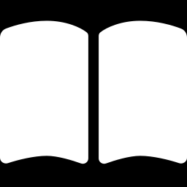
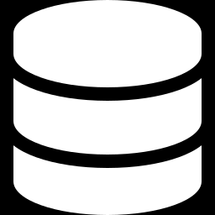
Background
Two linked but different layers of the Wikimedia knowledge ecosystem
Wikipedia
Wikidata
Language-specific encyclopedic narratives. Each language edition is written and curated independently — coverage, depth, and framing can differ from one language to the next.
One shared structured knowledge graph of entities and relationships, with language-dependent labels, descriptions, aliases, and links back to Wikipedia articles.
Distinct language editions · independent narratives
One shared graph · language-dependent labels
Prior research shows Wikimedia knowledge is unevenly represented across languages, regions, and social groups — and political knowledge is especially sensitive.
Cross-Linguistic Political Bias in the Wikimedia Ecosystem
2

Slide 3
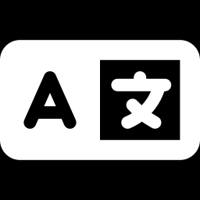
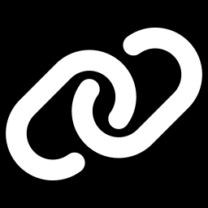
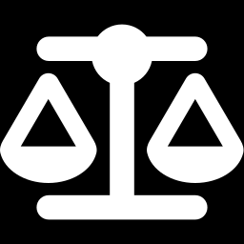
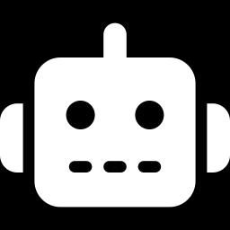
Problem Statement
A Nigerian political actor or party may have a detailed English Wikipedia article, but limited coverage in a Nigerian language — while its Wikidata item may have labels, descriptions, or references missing in some languages altogether.
Cross-language gaps
Weak sourcing
Missing articles, absent or limited Wikidata labels and descriptions across languages.
Incomplete statements and inconsistent reference coverage between languages.
Framing differences
Uncertain AI impact
Different narrative emphasis on the same political entity, language to language.
Multilingual AI differences can't automatically be blamed on Wikimedia — the model itself may carry pre-existing bias.
Cross-Linguistic Political Bias in the Wikimedia Ecosystem
3

Slide 4
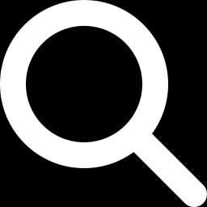
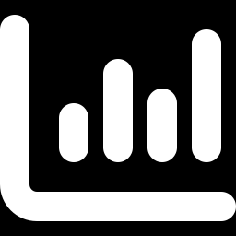
Aim of the Study
To quantify and compare political bias between English and selected Nigerian-language Wikimedia projects, in order to identify systemic neutrality gaps in regional political coverage.
Assess
Compare
Test
How political information varies across languages
Wikipedia vs. Wikidata consistency and completeness
Whether the gaps measurably affect AI outputs
Cross-Linguistic Political Bias in the Wikimedia Ecosystem
4

Slide 5
Specific Objectives
Three steps guide the study, from measurement to downstream AI impact
01
Assess variation
Examine how information about Nigerian political figures and institutions varies across languages on Wikipedia and Wikidata.
02
Test systematic patterns
Determine whether differences vary systematically by language, entity type, and salience — and check consistency between Wikipedia and Wikidata.
03
Trace AI impact
Test whether identified Wikimedia asymmetries measurably influence multilingual, knowledge-grounded AI outputs; derive indicators for continuous auditing.
Cross-Linguistic Political Bias in the Wikimedia Ecosystem
5

Slide 6
Research Questions
RQ1
RQ2
RQ3
How does information about Nigerian political figures and institutions vary across languages on Wikipedia and Wikidata?
Are observed differences systematically associated with language, political-entity type, or entity salience — and how consistent are Wikipedia and Wikidata representations of the same entities?
Do Wikimedia knowledge asymmetries produce measurable differences in multilingual AI outputs when equivalent political queries are tested under controlled retrieval conditions?
Cross-Linguistic Political Bias in the Wikimedia Ecosystem
6

Slide 7
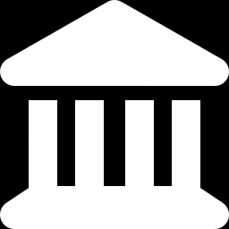
What the Literature Shows
Wikimedia projects are multilingual knowledge infrastructure — but the evidence base is uneven
Cultural imbalance
Demographic bias
Coverage & precision
Large content imbalances found across 40 Wikipedia language editions (Miquel-Ribé & Laniado, 2018).
Race and citizenship disparities identified in Wikidata (Shaik et al., 2021); bias varies by context (Das et al., 2023).
Non-English entity names and descriptions show lower coverage and precision in multilingual knowledge graphs (Conia et al., 2023).
Political distortion
Provenance gaps
Model-level effects
Notable over- and under-representation of political parties across DBpedia and Wikidata (Karadeniz et al., 2022).
Quality and accessibility of Wikidata sources vary by language (Amaral et al., 2021).
Cross-language differences in political ideology found in multilingual LLMs (Nadeem et al., 2026).
Cross-Linguistic Political Bias in the Wikimedia Ecosystem
7

Slide 8
Research Design
A comparative cross-sectional computational audit, with a controlled experimental component
Component 1 — The Audit
Component 2 — The AI Test
Observational & comparative
Controlled & experimental
Audits how selected Nigerian political entities are represented across relevant Wikipedia language editions and Wikidata — coverage, completeness, provenance, and framing.
A retrieval-augmented generation (RAG) experiment tests whether the Wikimedia asymmetries found in Component 1 influence downstream, multilingual AI outputs.
Nigeria's national political entities · English + selected Nigerian languages
Matched multilingual queries · no-retrieval, raw, and harmonised evidence conditions
Cross-Linguistic Political Bias in the Wikimedia Ecosystem
8

Slide 9
Data Sources & Instruments
SOURCES OF DATA
FOUR INSTRUMENTS
Wikidata
IDs, labels, descriptions, aliases, sitelinks, statements & references
1
Entity-sampling & benchmark matrix
Role, electoral relevance, Wikidata ID, available language pages
Wikipedia
Article presence, lead-section text, metadata across languages
2
R scripts & SPARQL/API templates
Reproducible extraction into structured datasets
External benchmarks
Electoral, parliamentary & government records
3
Structured audit checklist
Scores presence, completeness, reference coverage, consistency
AI experiment outputs
Responses to matched multilingual political queries
4
Framing-analysis codebook
Classifies omission, ideological wording, emphasis, contradiction
Cross-Linguistic Political Bias in the Wikimedia Ecosystem
9

Slide 10
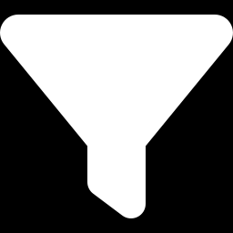
Analysis in Four Stages
R is the principal environment throughout — extraction, cleaning, analysis and visualisation
1
2
3
4
Descriptive coverage
Completeness & provenance
Framing divergence
AI propagation test
→
→
→
Article presence & label/description/sitelink coverage by language and entity type
Structured-completeness scores, reference proportions, cross-project consistency
Lexical similarity, key-term comparison, human-validated coding of framing
Compare no-retrieval, raw, and harmonised evidence conditions on AI outputs
Cross-Linguistic Political Bias in the Wikimedia Ecosystem
10

Slide 11
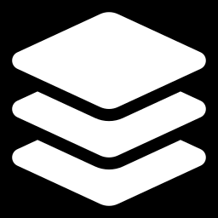
Expected Contribution & Significance
A reproducible framework
Distinguishes the layers
For auditing political knowledge across the linked Wikimedia ecosystem, Nigeria-focused.
Separates Wikipedia language-edition differences from Wikidata's shared structured layer.
Tests AI impact
Practical indicators
Shows whether Wikimedia gaps can affect knowledge-grounded AI responses.
An R-based workflow and audit indicators for Wikimedia communities, researchers, and AI developers.
Findings will target publication in a high-indexed, peer-reviewed Scopus journal — contributing to computational social science from the Global South, with a Nigerian perspective.
Cross-Linguistic Political Bias in the Wikimedia Ecosystem
11

Slide 12
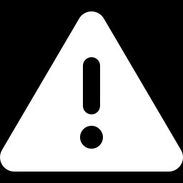
Anticipated Limitations
Honest boundaries on what the study can — and cannot — claim
Framing is contested
Sparse content
Cross-language differences are not automatically evidence of bias.
Some Nigerian-language Wikimedia content may limit statistical power — though absence is itself a finding.
A moving target
Bounded generalisation
Wikimedia content changes continuously; the study uses a fixed, time-bounded snapshot.
The downstream AI test cannot be generalised to every commercial system or hidden training corpus.
Cross-Linguistic Political Bias in the Wikimedia Ecosystem
12

Slide 13
Thank You
Questions & Discussion
Concept Note for Inclusive and Responsible AI — Group 3

